Slide 1
CS 4504 Parallel and Distributed Computing Process
Kun Suo
Computer Science, Kennesaw State University
https://kevinsuo.github.io/

Slide 2
Outline
What is process?
Process vs Program
Linux Process Control Block
Process related System calls
Fork
Exec
Wait
Process on Distributed OSes

Slide 3
Process
Definition
An instance of a program running on a computer
An abstraction that supports running programs - -> cpu virtualization
An execution stream in the context of a particular process state - -> dynamic unit
A sequential stream of execution in its own address space - -> execution code line by line

Slide 4
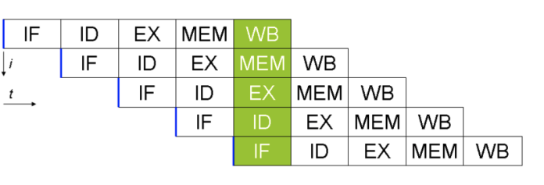
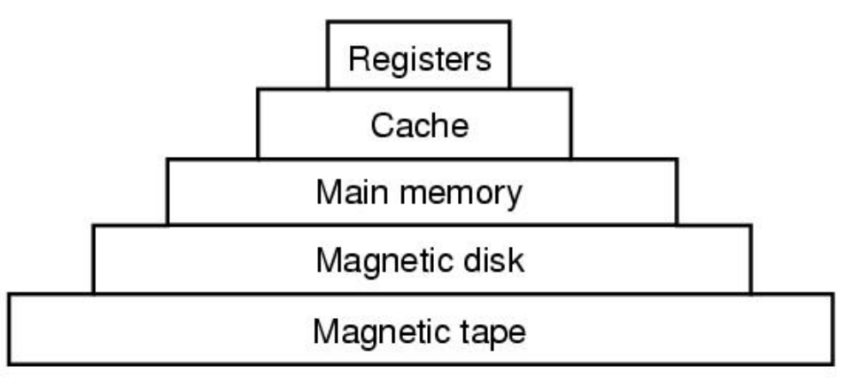
Process
Two parts of a process
Sequential execution of instructions
Process state
registers: PC (program counter), SP (stack pointer),…
Memory: address space, code, data, stack, heap …
I/O status: open files …

Slide 5
Program vs. Process
Program != Process
Program = static code + data
Process = dynamic instantiation of code + data + files …
No 1:1 mapping
Program : process = 1:N
A program can invoke many processes

Slide 6
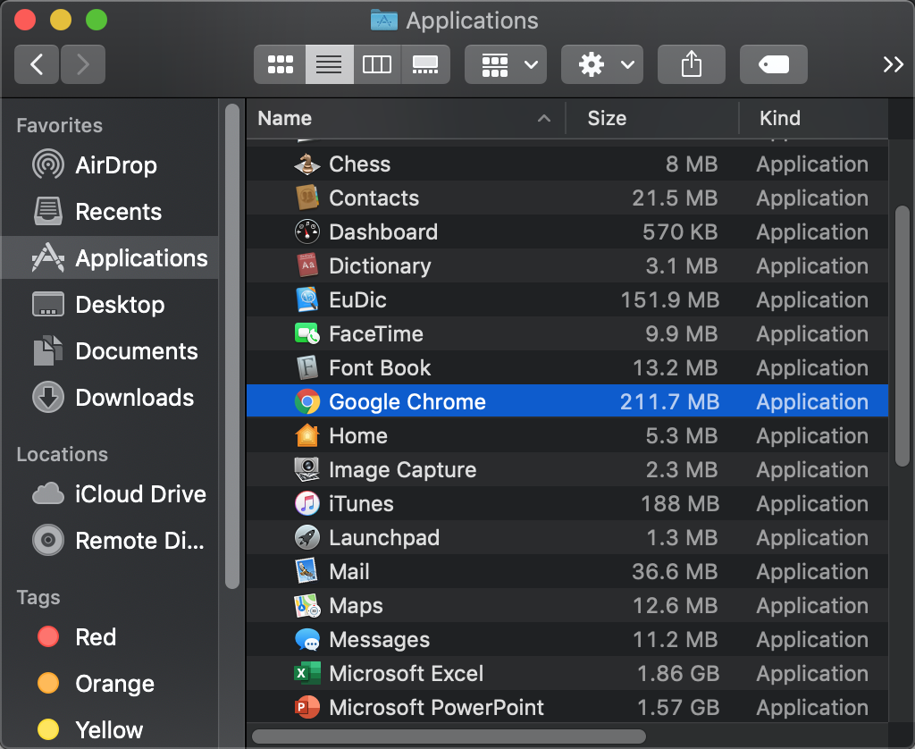
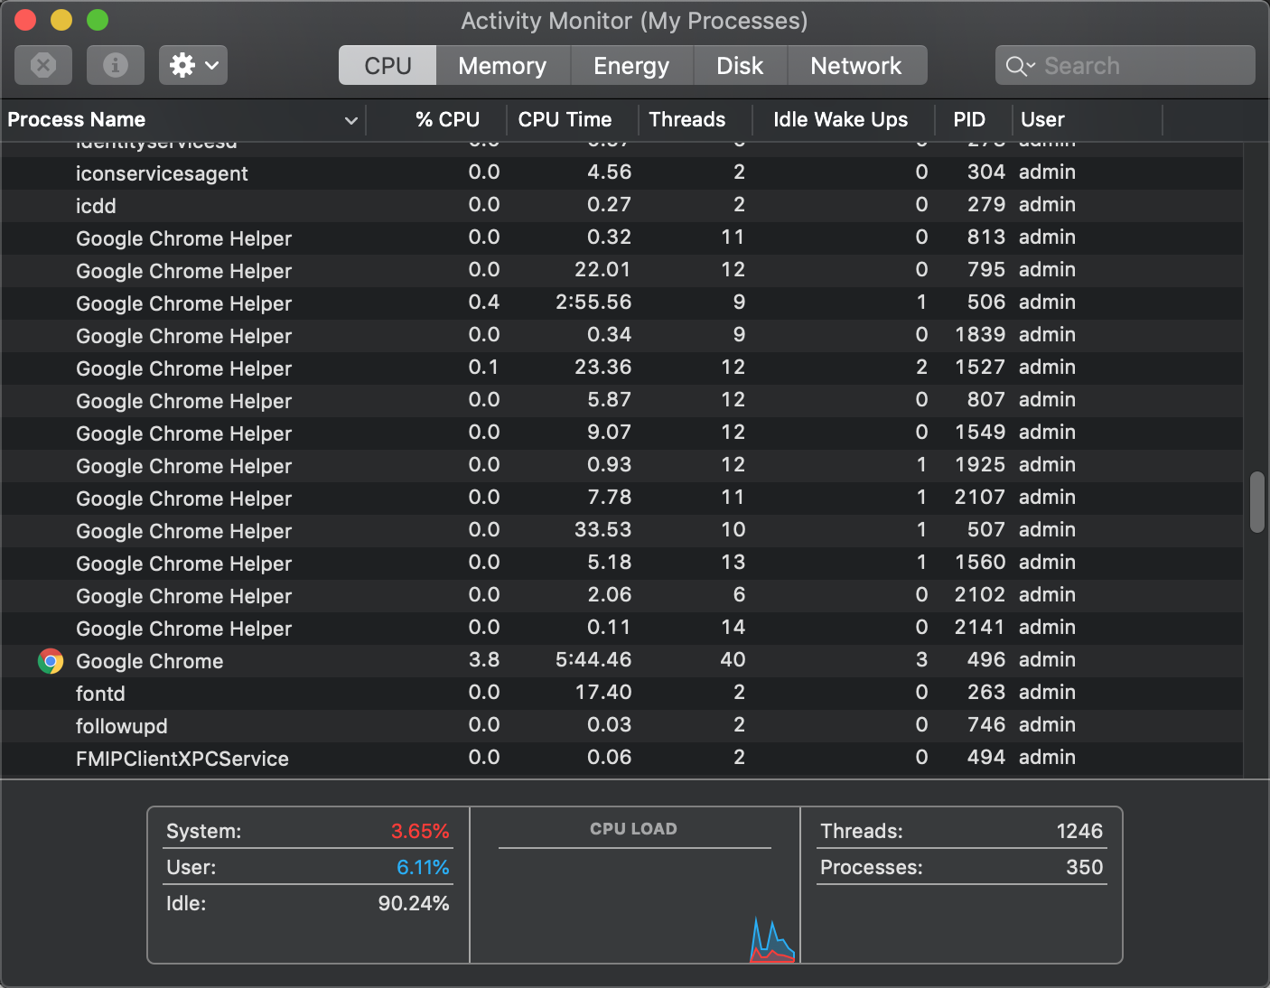
Program vs. Process
Process:
The running instantiation of a program, stored in RAM
Program:
An executable file in long-term storage
One-to-many relationship between program and processes

Slide 7
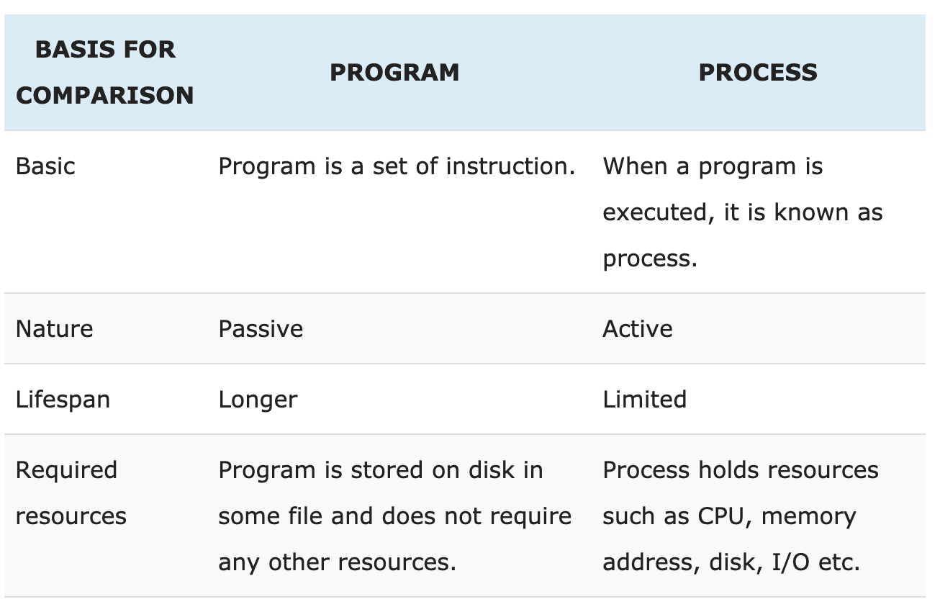
Program vs. Process
https://techdifferences.com/difference-between-program-and-process.html

Slide 8
Process Descriptor
Process
Driving license
ID
Name
Address
Birth
Time
…
Process control block (PCB)
State
Identifiers
Scheduling info
File system
Virtual memory
Process specific context
…

Slide 9
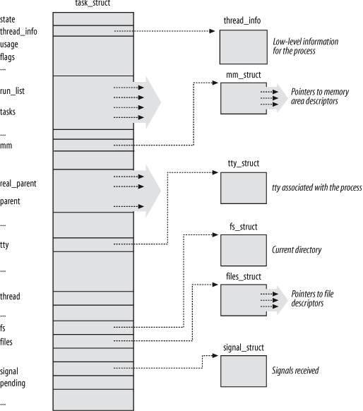
Process in Linux
https://elixir.bootlin.com/linux/v5.4/source/include/linux/sched.h#L624
Process control block (PCB)
State
Identifiers
Scheduling info
File system
Virtual memory
Process specific context
…

Slide 10
Process in Linux
Process control block (PCB)
State
Identifiers
Scheduling info
File system
Virtual memory
Process specific context
…

Slide 11
Linux PCB (5-state model to describe lifecycle of one process)
State
TASK_RUNNING
Running, ready
TASK_INTERRUPTABLE
Blocked
EXIT_ZOMBIE
Terminated by not deallocated
EXIT_DEAD
Completely terminated
new
admit
interrupt
exit
terminated
ready
running
I/O or event completion
scheduler dispatch
I/O or event wait
Blocked

Slide 12
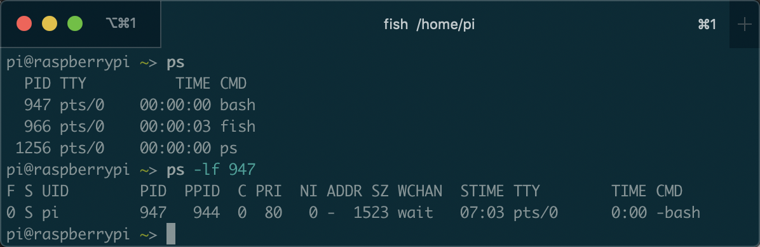
$ ps -lf : process information
Bash is a UNIX OS shell program
The state of the process
R ：The process is running
S ：The process is sleeping/idle
T ：The process is terminated
Z ：The process is in zombie state

Slide 13
$ ps -lf : process information
https://github.com/kevinsuo/CS7172/blob/master/sleep.c
https://github.com/kevinsuo/CS7172/blob/master/loop.c
Download: wget Raw-file-URL
Compile: gcc [file-name].c –o [file-name].o
Run: ./[file-name].o
What is the state of the process?

Slide 14
Process in Linux
Process control block (PCB)
State
Identifiers
Scheduling info
File system
Virtual memory
Process specific context
…

Slide 15
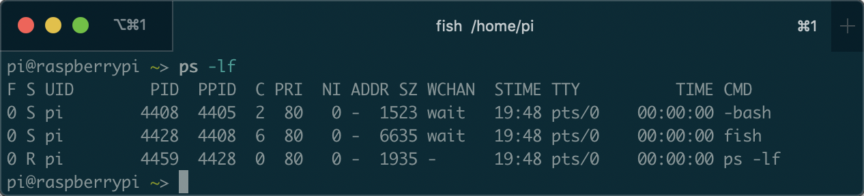
Linux Process Control Block (cont’)
Identifiers
pid: ID of the process
ID for this process
Parent process ID

Slide 16
Process in Linux
Process control block (PCB)
State
Identifiers
Scheduling info
File system
Virtual memory
Process specific context
…

Slide 17

Linux Process Control Block (cont’)
Scheduling information
prio, static_prio, normal_prio
rt_priority
sched_class

Slide 18
Linux Process Control Block (cont’)
Scheduling information
prio, static_prio, normal_prio
P₁
P₂
P₃
P₄
P₁
P₂
P₃
P₄
Static priority: P1 > P2 = P3 = P4, P1 can execute whenever it needs;
Normal priority: P1 = P2 = P3 = P4, P1 execute depending on the scheduling algorithm;
Prio: dynamic priority, will change over the time

Slide 19
Linux Process Control Block (cont’)
Scheduling information
rt_priority
P₁
P₂
P₃
P₄
P₁
P₂
P₃
P₄
Rt_priority process is always higher than other priority of processes and will be scheduled immediately when it needs

Slide 20
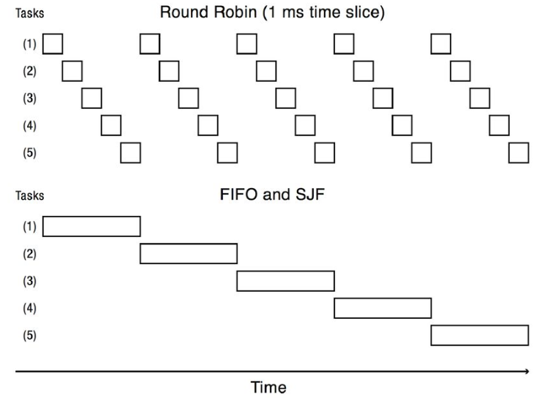
Linux Process Control Block (cont’)
Scheduling information
sched_class: different scheduling policy implementations, e.g., FIFO, SJF, RR…
Task->sched_class->pick_next_task(runqueue)
pick_next_task of RR:
pick based on time cycle
pick_next_task of FIFO:
pick based on order

Slide 21
$ ps -lf : process information
Bash is a UNIX OS shell program
How many cpus it consumes
Nice value: default is 0, could be modified to adjust the priority
Process priority value

Slide 22
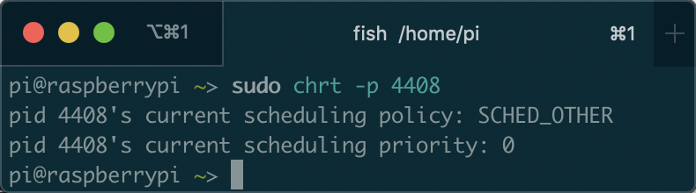
$ chrt: process scheduling info
scheduling policy
scheduling priority
SCHED_OTHER min/max priority : 0/0 SCHED_FIFO min/max priority : 1/99 SCHED_RR min/max priority : 1/99 SCHED_BATCH min/max priority : 0/0

Slide 23
Process in Linux
Process control block (PCB)
State
Identifiers
Scheduling info
File system
Virtual memory
Process specific context
…

Slide 24
Linux Process Control Block (cont’)
Files
fs_struct
file system information: root directory, current directory
https://elixir.bootlin.com/linux/v4.2/source/include/linux/sched.h#L1525

Slide 25
Linux Process Control Block (cont’)
Files
files_struct
Information on opened files
https://elixir.bootlin.com/linux/v4.2/source/include/linux/sched.h#L1528

Slide 26
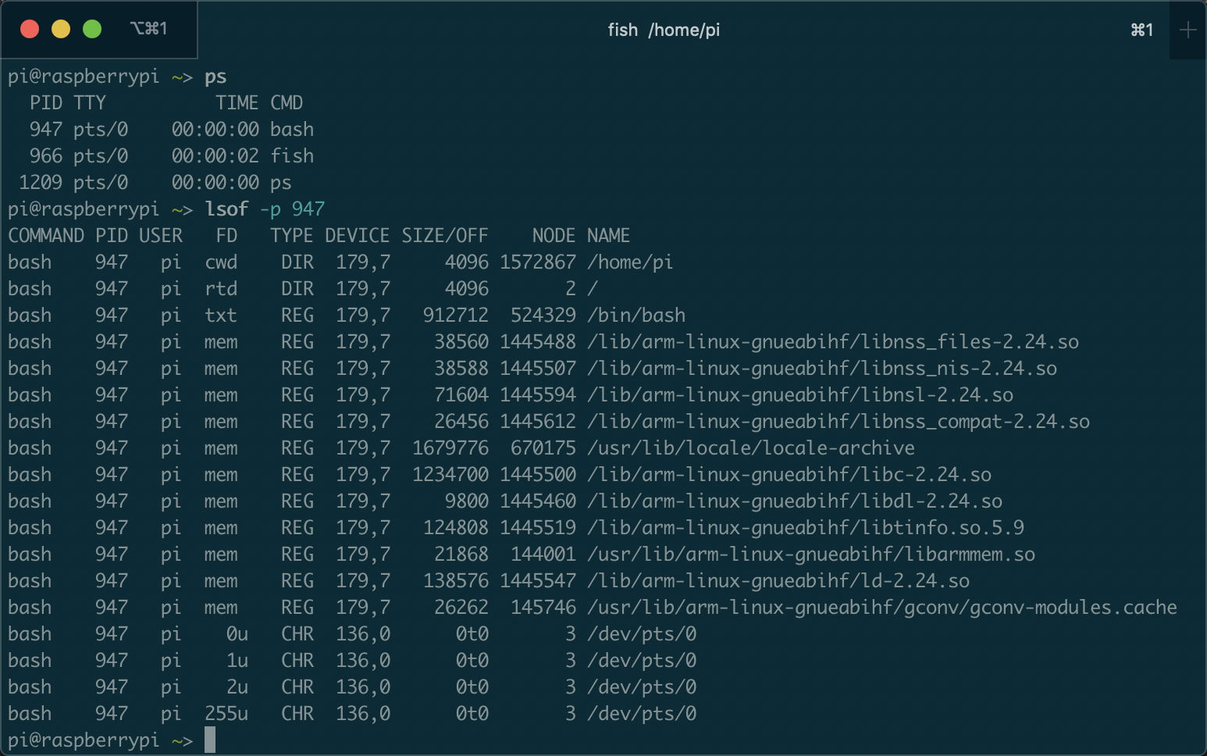
$lsof: list all open files
All files opened by bash
File descriptor, size, name, location, …

Slide 27
Process in Linux
Process control block (PCB)
State
Identifiers
Scheduling info
File system
Virtual memory
Process specific context
…

Slide 28
Linux Process Control Block (cont’)
Virtual memory
mm_struct: describes the content of a process’s virtual memory
The pointer to the page table and the virtual memory areas

Slide 29
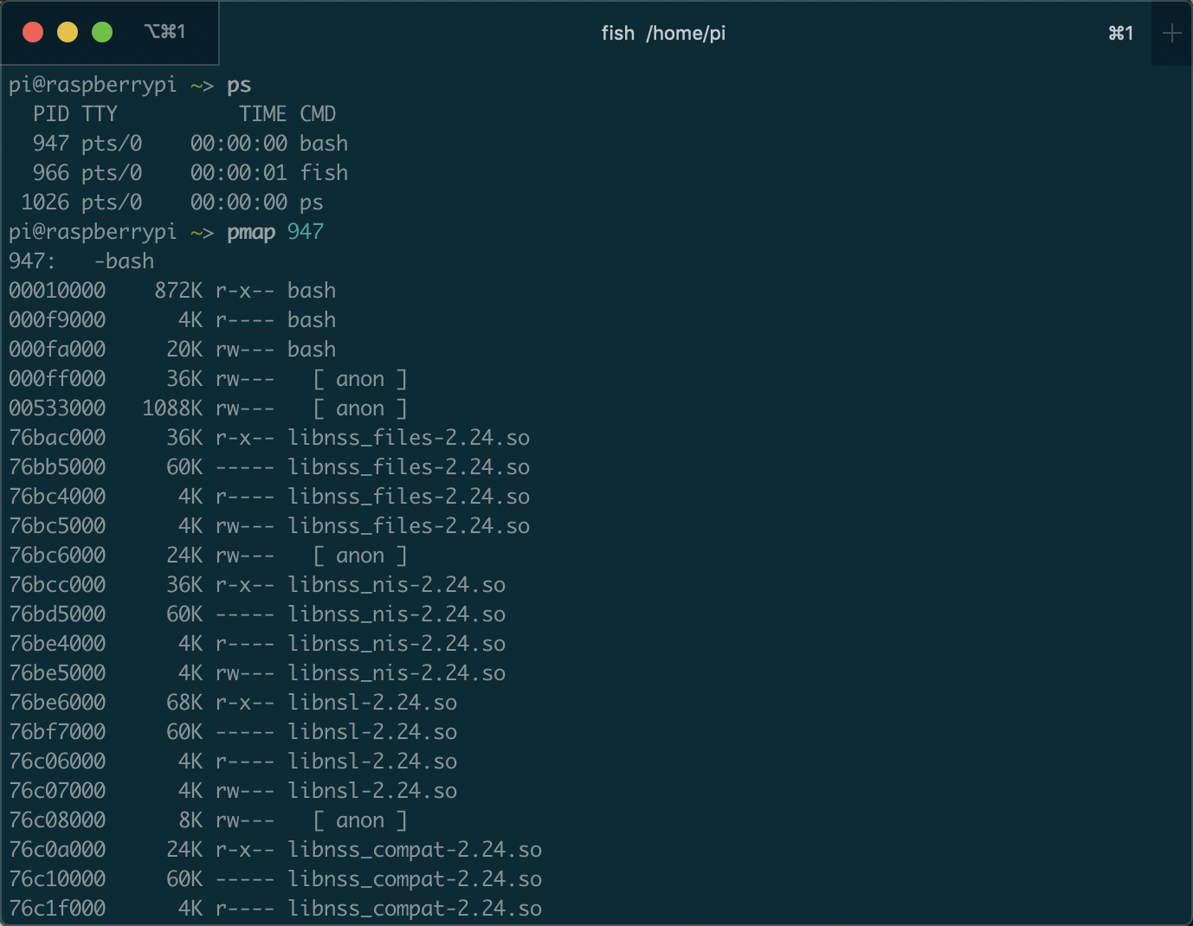
$pmap: memory mapping
All memory accessed by bash
Memory address
size
memory used by process bash
Read/write/execution permission
Lib/execution file

Slide 30
$pmap: memory mapping
Memory address
Code loaded by bash
Constant/static variable loaded by bash
size
Data loaded by bash
Read/write/execution permission
Lib/execution file

Slide 31
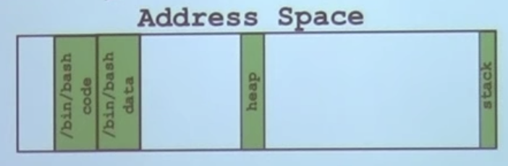
$pmap: memory mapping
Bash in memory
Memory address
size
Read/write/execution permission
Lib/execution file

Slide 32
Outline
What is process?
Process vs Program
Linux Process Control Block
Process related System calls
Fork
Exec
Wait
Process on Distributed OSes

Slide 33
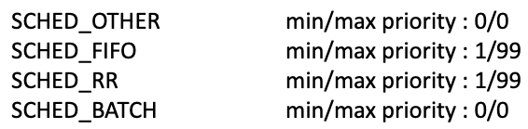
Test: create a process and show the following information of it
https://github.com/kevinsuo/CS7172/blob/master/sleep.c
Download: wget Raw-file-URL
Compile: gcc [file-name].c –o [file-name].o
Run: ./[file-name].o
What is the process ID?
What is the process state?
What is the scheduling policy for the process?
Show all files the process it is using.
Show all memory the process it is using.
Notes:
https://github.com/kevinsuo/CS7172/blob/master/sleep.c

Slide 34
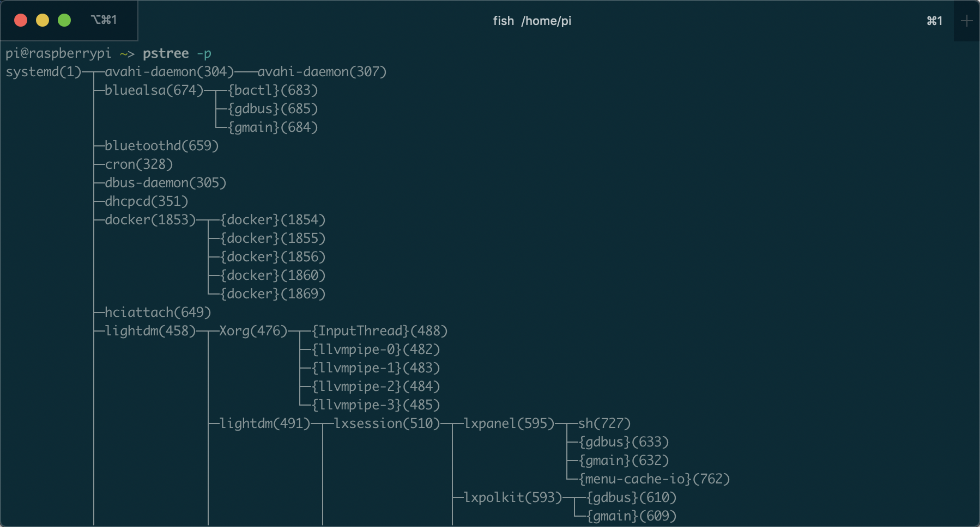
Where do processes come from?
Process creation always uses fork() system call

Slide 35
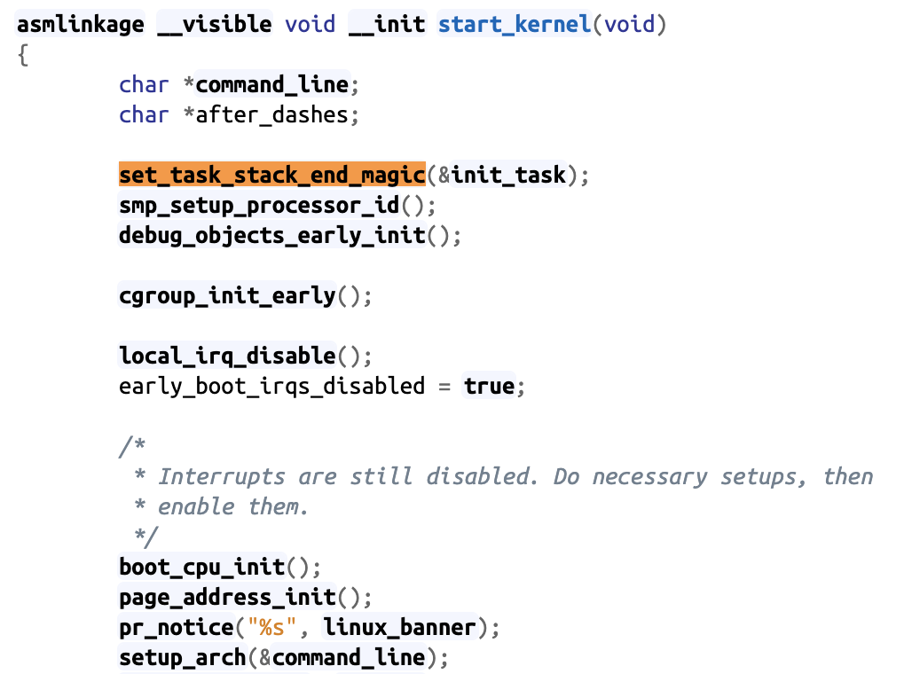
Where do processes come from? First process in the kernel
The start of linux kernel begins from start_kernel() function, it is equal to the main function of kernel
set_task_stack_end_magic() creates the first process in the OS
The first process is the only one which is not created by fork function
https://elixir.bootlin.com/linux/v5.4/source/init/main.c#L580

Slide 36
Fork() system call
Process creation always uses fork() system call
When?
User runs a program at command line
$./test.o
OS creates a process to provide a service
Timer, networking, load-balance, daemon, etc.
One process starts another process
Parents and child process

Slide 37
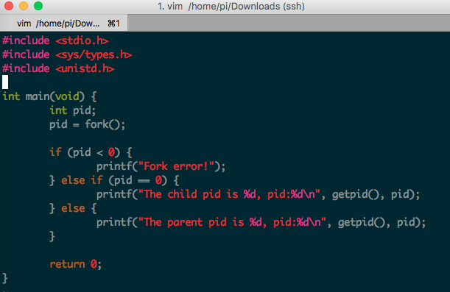
Fork() system call
https://github.com/kevinsuo/CS7172/blob/master/fork.c
Notes:
#include <stdio.h>
#include <sys/types.h>
#include <unistd.h>
int main(void) {
int pid;
pid = fork();
if (pid < 0) {
printf("Fork error!");
} else if (pid == 0) {
printf("The child pid is %d, pid:%d\n", getpid(), pid);
} else {
printf("The parent pid is %d, pid:%d\n", getpid(), pid);
}
return 0;
}

Slide 38
Fork() system call
fork() is called once. But it returns twice!!
Once in the parent (return child id > 0)
Once in the child (return 0)

Slide 39
Fork() system call
https://github.com/kevinsuo/CS7172/blob/master/fork.c
fork() is called once. But it returns twice!!
Notes:
#include <stdio.h>
#include <sys/types.h>
#include <unistd.h>
int main(void) {
int pid;
pid = fork();
if (pid < 0) {
printf("Fork error!");
} else if (pid == 0) {
printf("The child pid is %d, pid:%d\n", getpid(), pid);
} else {
printf("The parent pid is %d, pid:%d\n", getpid(), pid);
}
return 0;
}

Slide 40
Fork() system call
fork() is the UNIX system call that creates a new process.
fork() creates a new process that is a copy of the calling process.
After fork () we refer to the caller as the parent and the newly-created process as the child. They have a special relationship and special responsibilities.

Slide 41
Parent process and child process
When a parent process uses fork() to create a child process, the two processes have
the same program text.
but separate copies of the data, stack, and heap segments.

Slide 42
Parent process and child process
The child’s stack, data, and heap segments are initially exact duplicates of the corresponding parts the parent’s memory.
After the fork(), each process can modify the variables in its own data, stack, and heap segments without affecting the other process.

Slide 43
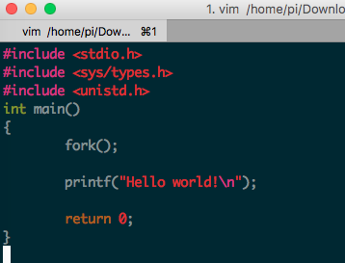
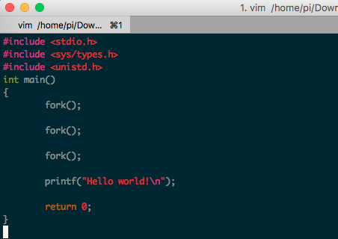
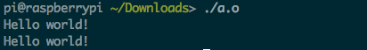
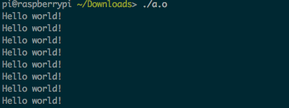
Fork() example
Parent
Child

Slide 44
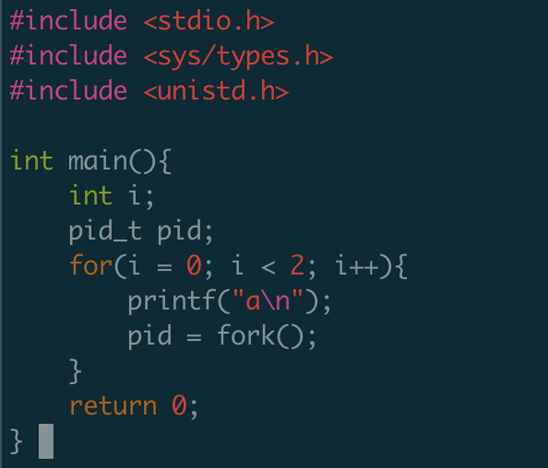
Fork() example
How many a it will output?

Slide 45
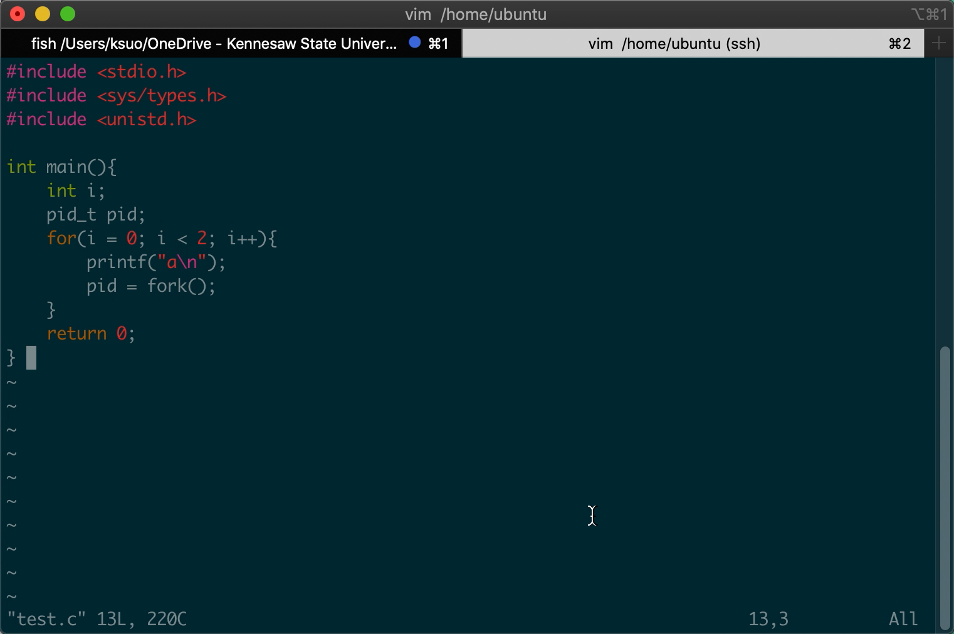
Fork() example

Slide 46
Fork() example
How many a it will output?
Main: a
Create a process named 111
i=0
Main: a
Create a process named 222
111: a
Create a process named 333
i=1

Slide 47
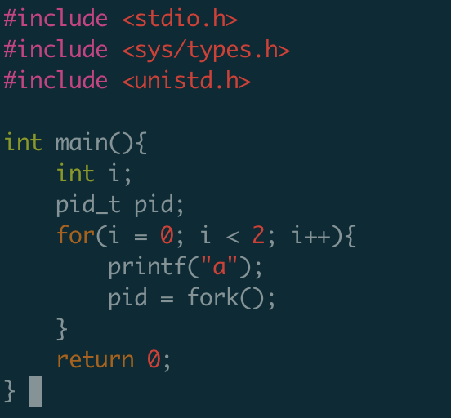
Fork() example
How many a it will output?

Slide 48
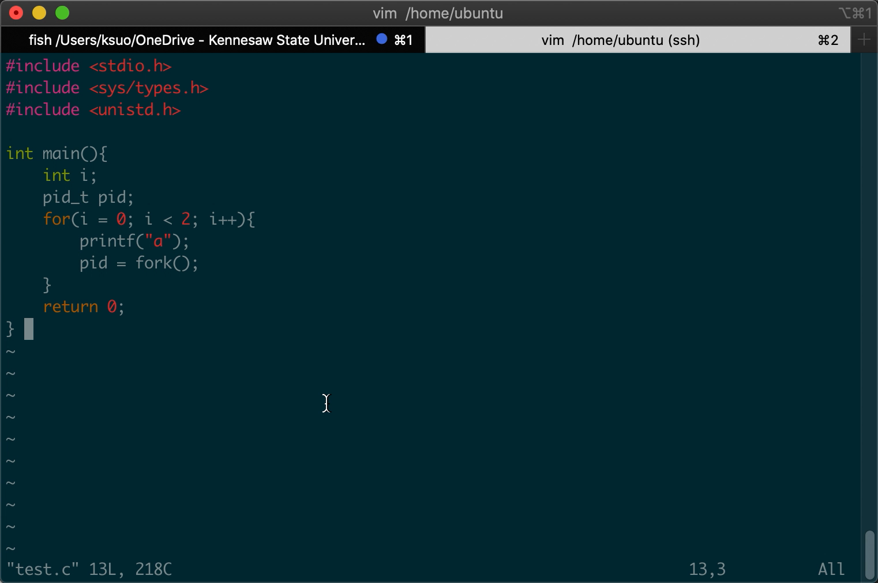
Fork() example
How many a it will output?

Slide 49
Fork() example
Printf (without /n) will not flush the buffer until the program finished
main
Main: a
Create a process named 111
i=0
Main: a
Create a process named 222
111: a
Create a process named 333
i=1

Slide 50
Fork() example
Printf (without /n) will not flush the buffer until the program finished
main
111
Main: a
Create a process named 111
i=0
Main: a
Create a process named 222
111: a
Create a process named 333
i=1

Slide 51
Fork() example
Printf (without /n) will not flush the buffer until the program finished
main
111
Main: a
Create a process named 111
i=0
222
Main: a
Create a process named 222
111: a
Create a process named 333
i=1

Slide 52
Fork() example
Printf (without /n) will not flush the buffer until the program finished
main
111
Main: a
Create a process named 111
i=0
222
Main: a
Create a process named 222
111: a
Create a process named 333
i=1
333

Slide 53
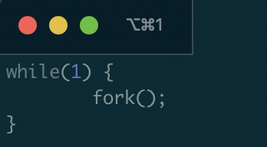
A fork() bomb
What does this code do?
Agent smith

Slide 54
Test
Assume the following code is compiled and run on a modern Linux machine (assume any irrelevant details have been omitted):
main() {
int i = 0;
int rc = fork();
i++;
if (rc == 0) {
rc = fork();
i++;
} else {
i++;
}
printf(“Hello!\n”);
printf(“i is %d\n”, i);
}
Assuming fork() never fails, how many times will the message “Hello!\n” be displayed? And explain your answer.
a) 2
b) 3
c) 4
d) 6
e) None of the above

Slide 55
Test
Assume the following code is compiled and run on a modern Linux machine (assume any irrelevant details have been omitted):
main() {
int i = 0;
int rc = fork();
i++;
if (rc == 0) {
rc = fork();
i++;
} else {
i++;
}
printf(“Hello!\n”);
printf(“i is %d\n”, i);
}
Assuming fork() never fails, how many times will the message “Hello!\n” be displayed? And explain your answer.
a) 2
b) 3
c) 4
d) 6
e) None of the above

Slide 56
Test
Assume the following code is compiled and run on a modern Linux machine (assume any irrelevant details have been omitted):
main() {
int a = 0;
int rc = fork();
a++;
if (rc == 0) {
rc = fork();
a++;
} else {
a++;
}
printf(“Hello!\n”);
printf(“a is %d\n”, a);
}
What will be the largest value of “a” displayed by the program? And explain your answer.
a) Due to race conditions, “a” may have different values on different runs of the program.
b) 2
c) 3
d) 5
e) None of the above

Slide 57
Test
Separate copies of a in each process:
Parent process: a = 0; a++; a++; → a=2.
Child process: a=0 (after fork()); a++; a++; → a=2.
Grandchild: a=1 (after fork()); a++; → a =2.
(2.1) For the next two questions, assume the following code is compiled and run on a modern Linux machine (assume any irrelevant details have been omitted):
main() {
int a = 0;
int rc = fork();
a++;
if (rc == 0) {
rc = fork();
a++;
} else {
a++;
}
printf(“Hello!\n”);
printf(“a is %d\n”, a);
}
a
0

Slide 58
Test
Separate copies of a in each process:
Parent process: a = 0; a++; a++; → a=2.
Child process: a=0 (after fork()); a++; a++; → a=2.
Grandchild: a=1 (after fork()); a++; → a =2.
(2.1) For the next two questions, assume the following code is compiled and run on a modern Linux machine (assume any irrelevant details have been omitted):
main() {
int a = 0;
int rc = fork();
a++;
if (rc == 0) {
rc = fork();
a++;
} else {
a++;
}
printf(“Hello!\n”);
printf(“a is %d\n”, a);
}
a
a
0
0

Slide 59
Test
Separate copies of a in each process:
Parent process: a = 0; a++; a++; → a=2.
Child process: a=0 (after fork()); a++; a++; → a=2.
Grandchild: a=1 (after fork()); a++; → a =2.
(2.1) For the next two questions, assume the following code is compiled and run on a modern Linux machine (assume any irrelevant details have been omitted):
main() {
int a = 0;
int rc = fork();
a++;
if (rc == 0) {
rc = fork();
a++;
} else {
a++;
}
printf(“Hello!\n”);
printf(“a is %d\n”, a);
}
a
a
1
1

Slide 60
Test
Separate copies of a in each process:
Parent process: a = 0; a++; a++; → a=2.
Child process: a=0 (after fork()); a++; a++; → a=2.
Grandchild: a=1 (after fork()); a++; → a =2.
(2.1) For the next two questions, assume the following code is compiled and run on a modern Linux machine (assume any irrelevant details have been omitted):
main() {
int a = 0;
int rc = fork();
a++;
if (rc == 0) {
rc = fork();
a++;
} else {
a++;
}
printf(“Hello!\n”);
printf(“a is %d\n”, a);
}
a
a
a
1
1
1

Slide 61
Test
Separate copies of a in each process:
Parent process: a = 0; a++; a++; → a=2.
Child process: a=0 (after fork()); a++; a++; → a=2.
Grandchild: a=1 (after fork()); a++; → a =2.
(2.1) For the next two questions, assume the following code is compiled and run on a modern Linux machine (assume any irrelevant details have been omitted):
main() {
int a = 0;
int rc = fork();
a++;
if (rc == 0) {
rc = fork();
a++;
} else {
a++;
}
printf(“Hello!\n”);
printf(“a is %d\n”, a);
}
a
a
a
1
2
2

Slide 62
Test
Separate copies of a in each process:
Parent process: a = 0; a++; a++; → a=2.
Child process: a=0 (after fork()); a++; a++; → a=2.
Grandchild: a=1 (after fork()); a++; → a =2.
(2.1) For the next two questions, assume the following code is compiled and run on a modern Linux machine (assume any irrelevant details have been omitted):
main() {
int a = 0;
int rc = fork();
a++;
if (rc == 0) {
rc = fork();
a++;
} else {
a++;
}
printf(“Hello!\n”);
printf(“a is %d\n”, a);
}
a
a
a
2
2
2

Slide 63
Test
Separate copies of a in each process:
Parent process: a = 0; a++; a++; → a=2.
Child process: a=0 (after fork()); a++; a++; → a=2.
Grandchild: a=1 (after fork()); a++; → a =2.
(2.1) For the next two questions, assume the following code is compiled and run on a modern Linux machine (assume any irrelevant details have been omitted):
main() {
int a = 0;
int rc = fork();
a++;
if (rc == 0) {
rc = fork();
a++;
} else {
a++;
}
printf(“Hello!\n”);
printf(“a is %d\n”, a);
}
a
a
a
2
2
2

Slide 64
Test
(2.1) For the next two questions, assume the following code is compiled and run on a modern Linux machine (assume any irrelevant details have been omitted):
main() {
int a = 0;
int rc = fork();
a++;
if (rc == 0) {
rc = fork();
a++;
} else {
a++;
}
printf(“Hello!\n”);
printf(“a is %d\n”, a);
}
What will be the largest value of “a” displayed by the program? And explain your answer.
a) Due to race conditions, “a” may have different values on different runs of the program.
b) 2
c) 3
d) 5
e) None of the above

Slide 65
Exec() system call
Replaces current process image with new program image.
Exec system call is a collection of functions and in C programming language, the standard names for these functions are as follows:
int execl(const char* path, const char* arg, …)
int execlp(const char* file, const char* arg, …)
int execle(const char* path, const char* arg, …, char* const envp[])
int execv(const char* path, const char* argv[])
int execvp(const char* file, const char* argv[])
int execvpe(const char* file, const char* argv[], char *const envp[])

Slide 66
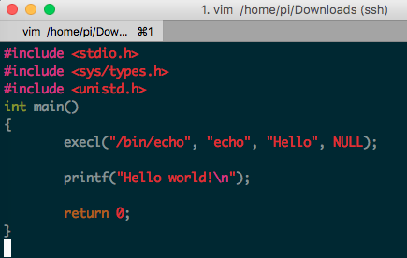
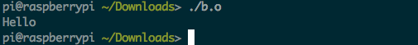
Exec() system call
Replaces current process image with new program image.
Parent
Parent
Child

Slide 67
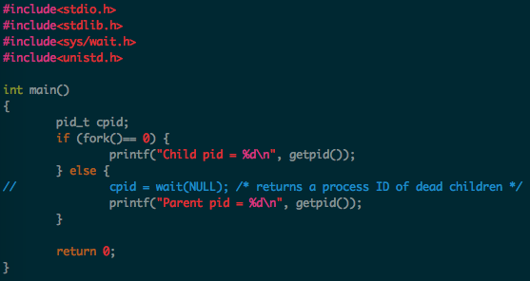
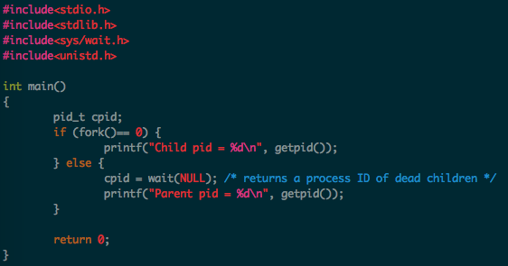
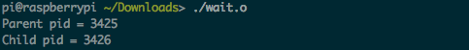
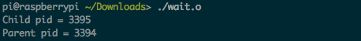
Wait() system call
https://github.com/kevinsuo/CS7172/blob/master/wait.c
Helps the parent process
to know when a child completes
to check the return status of child
Notes:
#include <stdio.h>
#include <sys/types.h>
#include <unistd.h>
int main(void) {
int pid;
pid = fork();
if (pid < 0) {
printf("Fork error!");
} else if (pid == 0) {
printf("The child pid is %d, pid:%d\n", getpid(), pid);
} else {
printf("The parent pid is %d, pid:%d\n", getpid(), pid);
}
return 0;
}

Slide 68
Few other useful syscalls
sleep(seconds)
suspend execution for certain time
exit(status)
Exit the program.
Status is retrieved by the parent using wait().
0 for normal status, non-zero for error
kill(pid_t pid, int sig)
Kill certain process

Slide 69
Outline
What is process?
Process vs Program
Linux Process Control Block
Process related System calls
Fork
Exec
Wait
Process on Distributed OSes

Slide 70
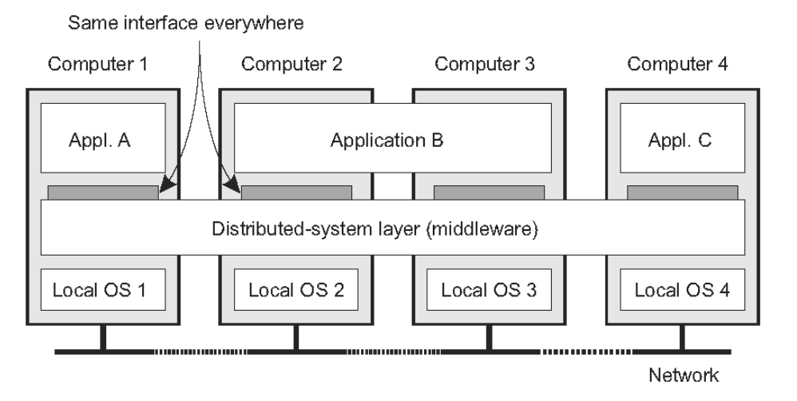
The OS of Distributed Systems
Commonly used components and functions for distributed applications

Slide 71
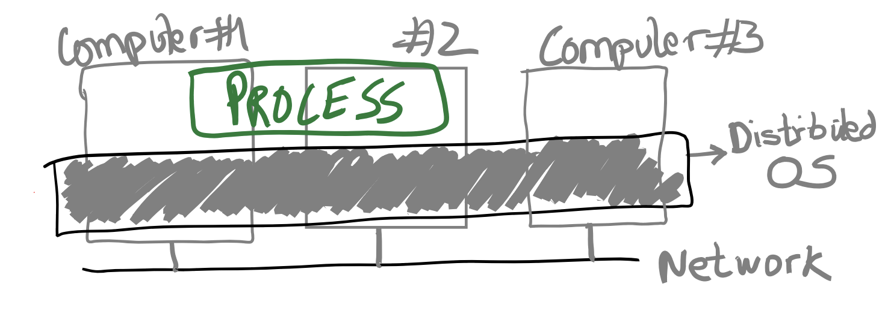
The OS of Distributed Systems
An OS that spans multiple computers
Same OS services, functionality, and abstractions as single-machine OS

Slide 72
Discussion
What could be the challenges for distributed OS?

Slide 73
Distributed OS Challenges
Providing the process abstraction and resource virtualization is hard
Resource virtualization must be transparent
But in distributed settings, there’s always a distinction between local and remote resources
In a single-machine OS, processes don’t care where their resources are coming from:
Which CPU cores, when they are scheduled, which physical memory pages they use, etc.
In fact, providing abstract, virtual resources is one of the main OS services

Slide 74
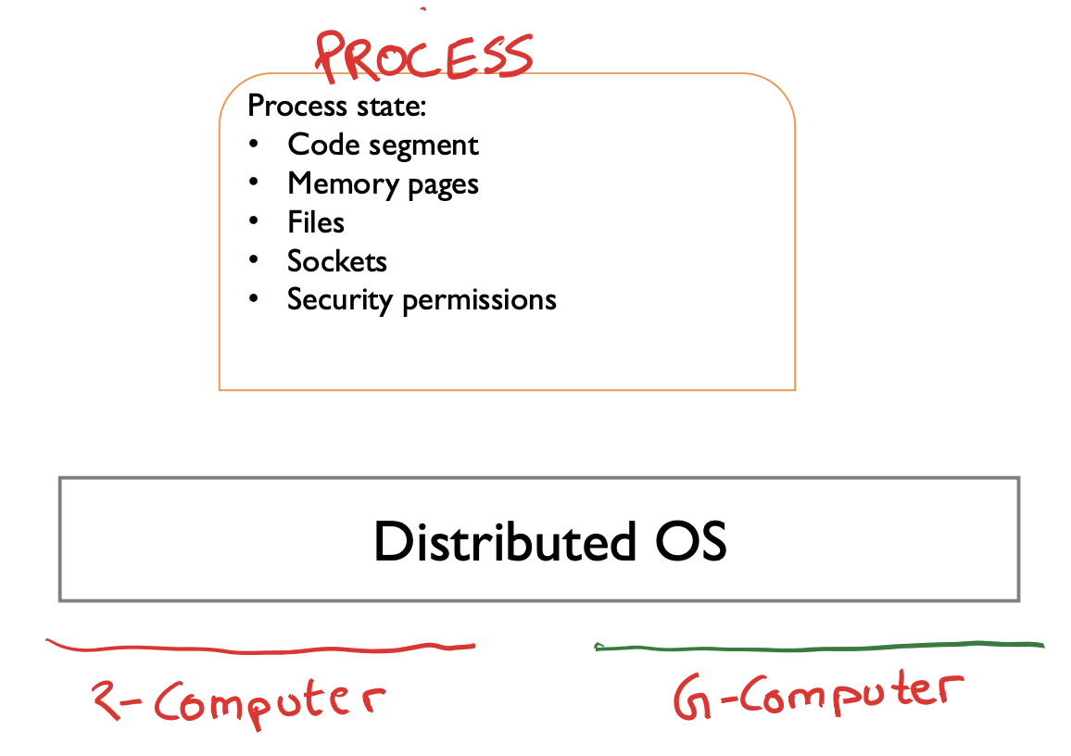
Transparency Issues In Distributed OS
• Where does code run?
• Which memory is used?
Local vs. remote
• How are files accessed?

Slide 75
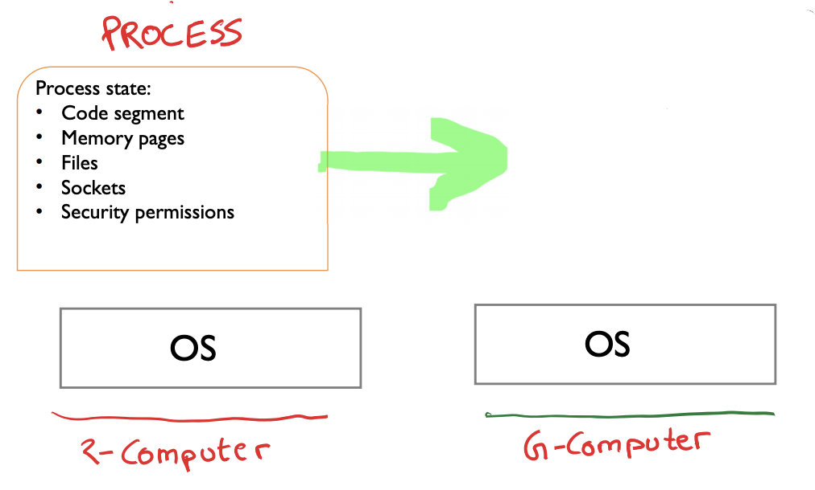
Process Migration
Move all process state from one computer to another
Process state can be vast
Also entangled with other process states
Shared files?
IPC (pipes etc)

Slide 76

Process Migration
Migrate some state? Other state, if required, is accessed over the network?
Example: migrate only fraction of pages. Other pages are copied over the network on access?
Access remote hardware devices (GPUs)?

Slide 77
Conclusion
What is process?
Process vs Program
Linux Process Control Block
Process related System calls
Fork, etc.
Process on Distributed OSes

